Slide 1


Low-fi Prototyping &
Pilot Usability Testing
Natasha Goh, Ben Gregory, Michelle Huang, Cooper Reed

Slide 2

Overview
Mission Statement
Selected Interface
Low-fi Prototype
Experiment
UI Changes
Summary

Slide 3

Mission Statement
We want to empower people to shop locally with the confidence that their values are being met.

Slide 4
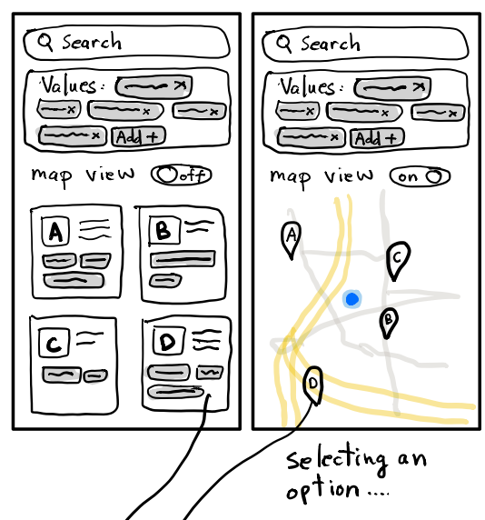
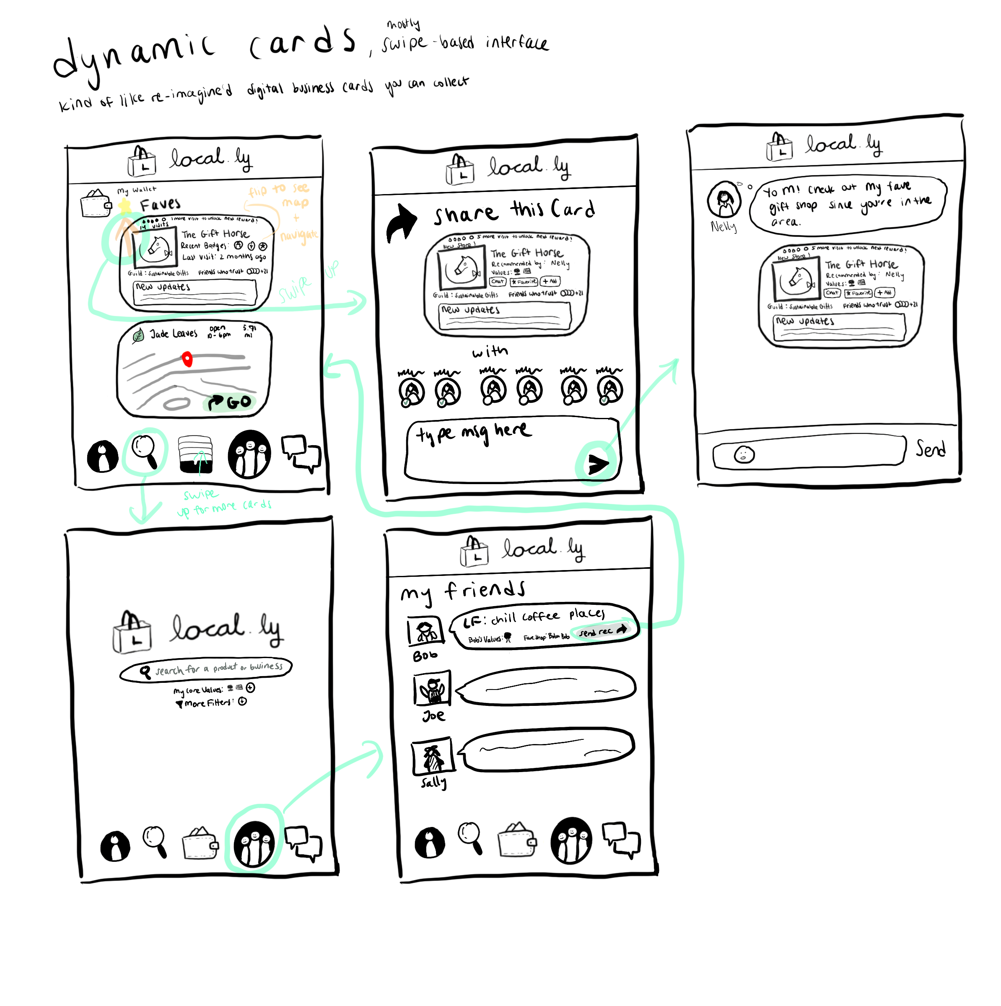
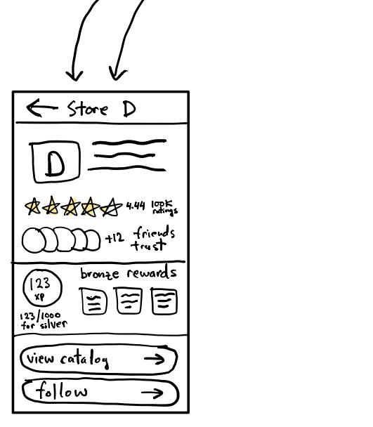
Selected Interface
Dynamic Cards
Digital business cards you can share
Value-Driven Search
Advanced search centered on values and trust

Slide 5
Selected Interface
Dynamic Cards
More playful & fun
Analogous to real world business cards
Cards could embody relationships
Easy integration with other ideas
Notes:
Also could be integrated w/ value-driven search

Slide 6
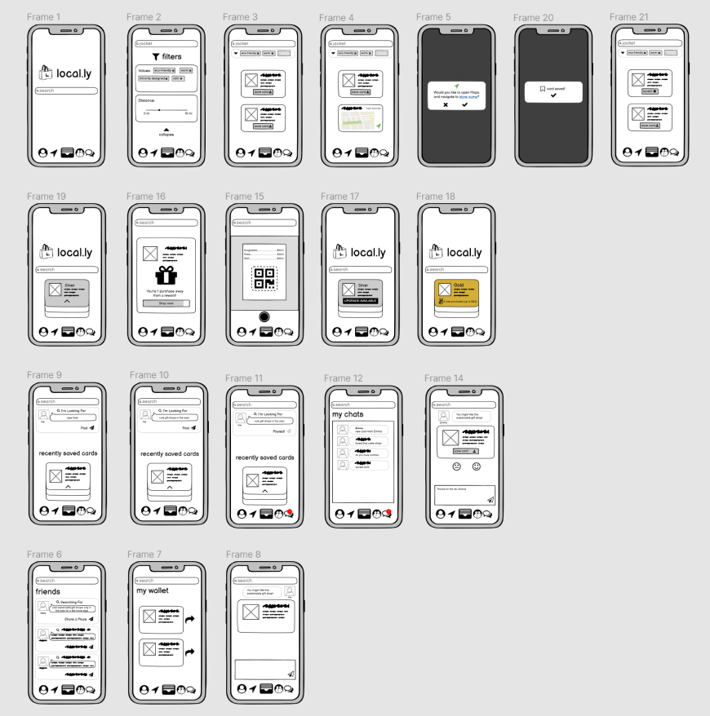
Low-Fi Prototype
Designed in Balsamiq
Wireframed in Figma
Phone Interface
Tap / Swipe Interface with some typing
Notes:
He makes notes of recommendations from colleagues / friends and girlfriend keeps detailed maps of pinned locations

Slide 7
Task #1
Buy value-driven product(s) locally
Notes:
He makes notes of recommendations from colleagues / friends and girlfriend keeps detailed maps of pinned locations

Slide 8
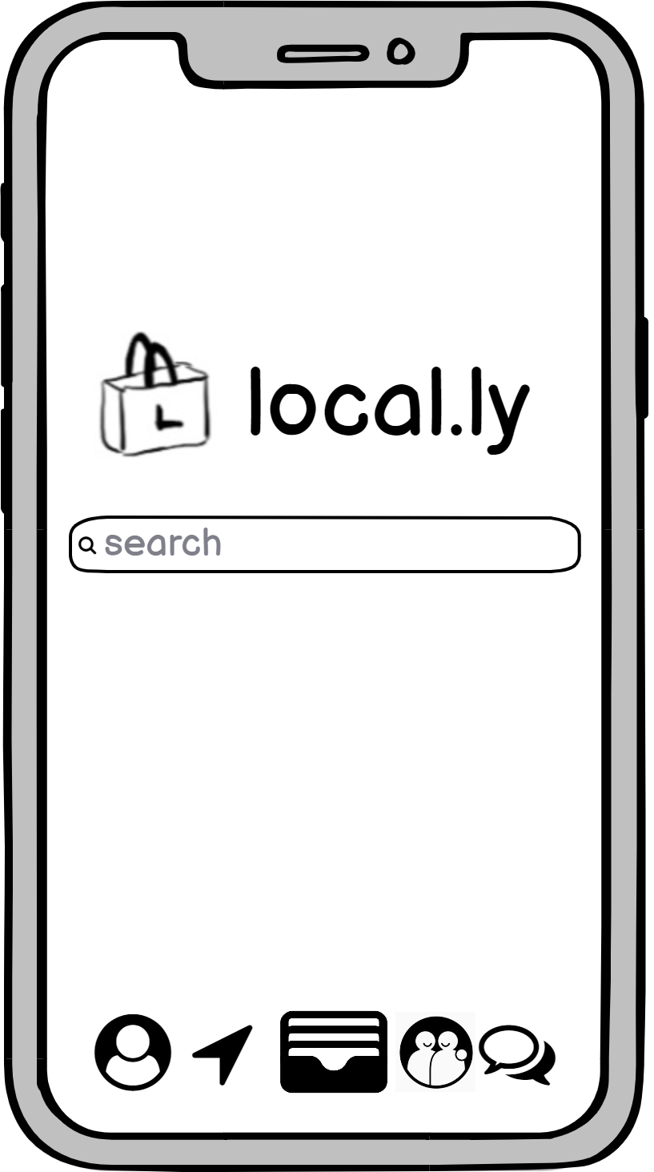
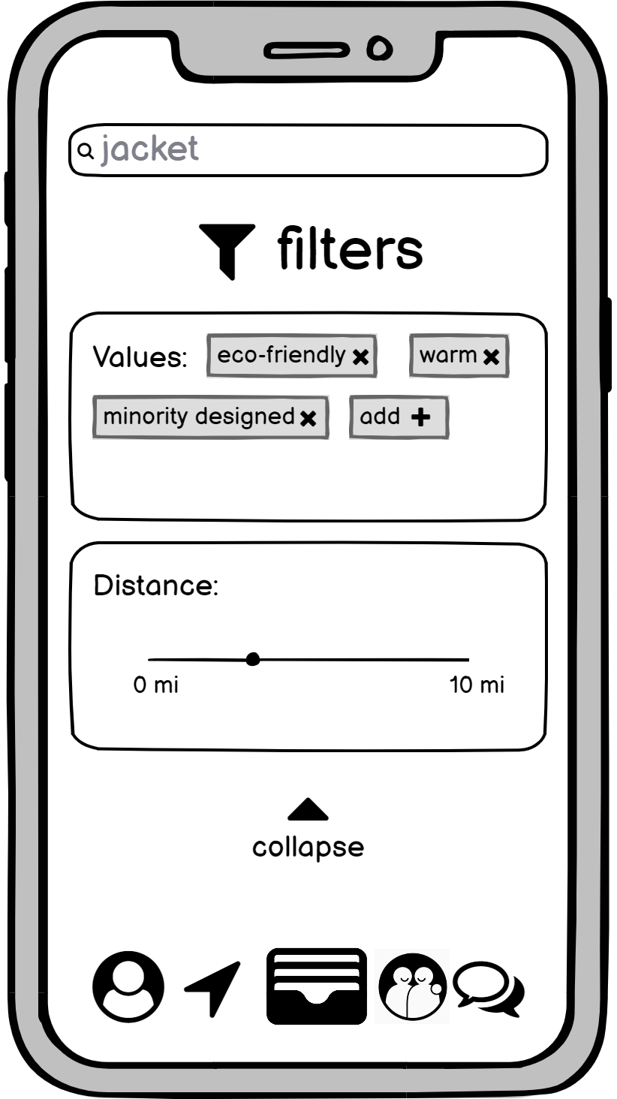
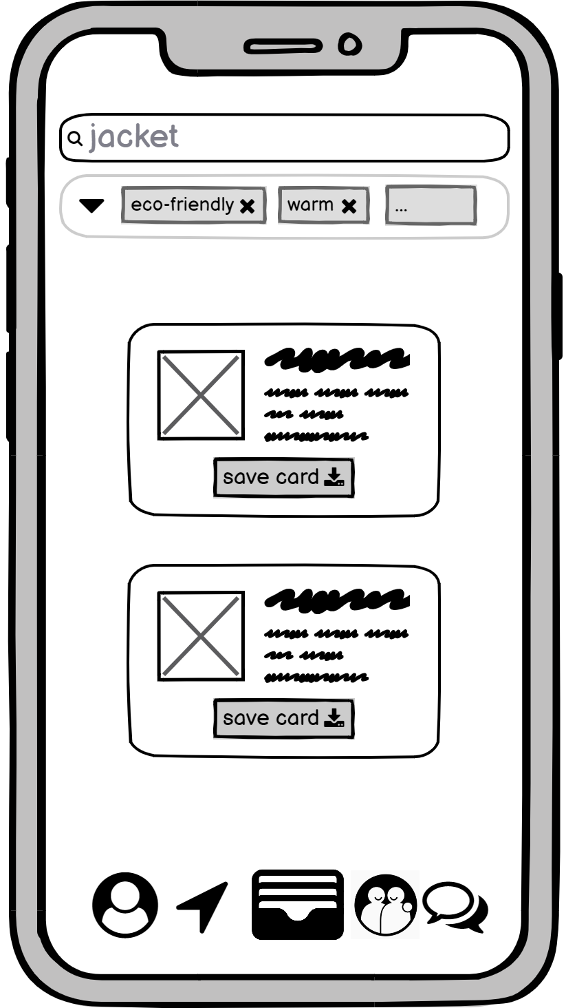
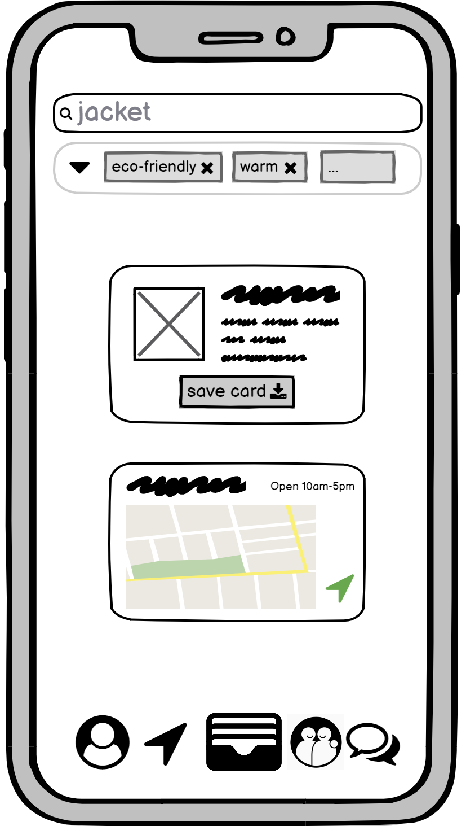
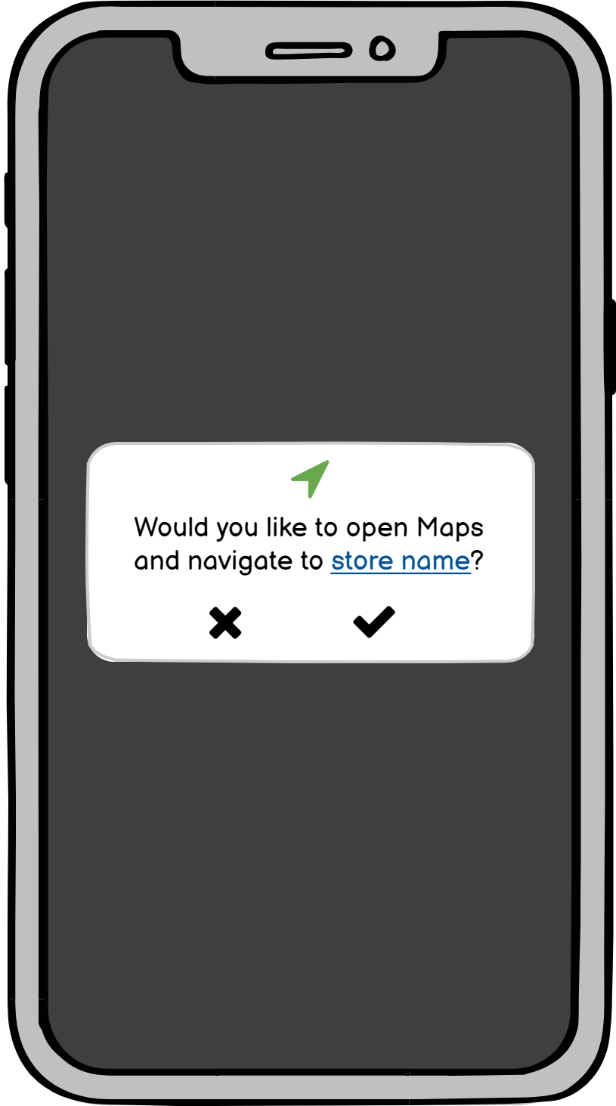
Task #1 - Buy value-driven product(s) locally

Slide 9
Task #2
Build relationships with local businesses
Notes:
He makes notes of recommendations from colleagues / friends and girlfriend keeps detailed maps of pinned locations

Slide 10
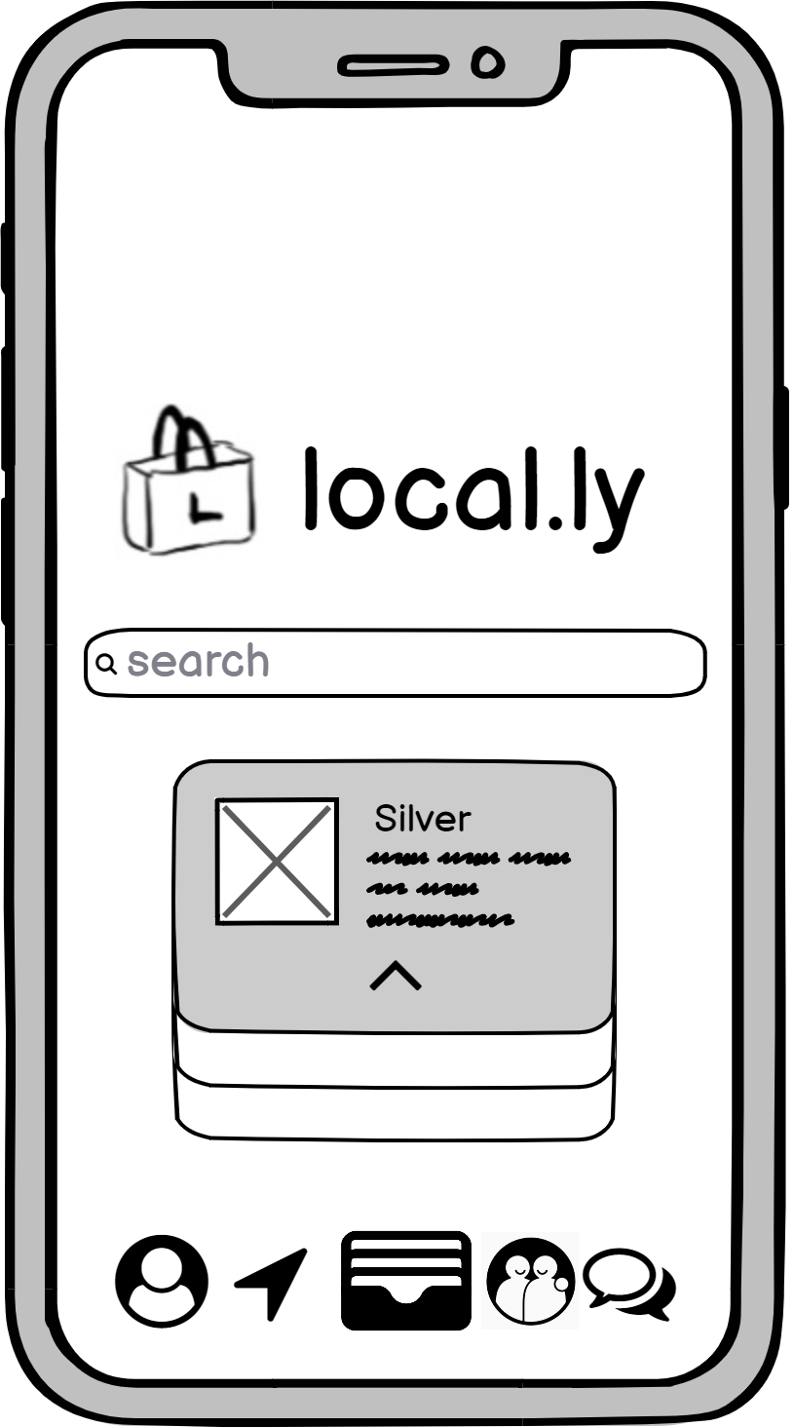
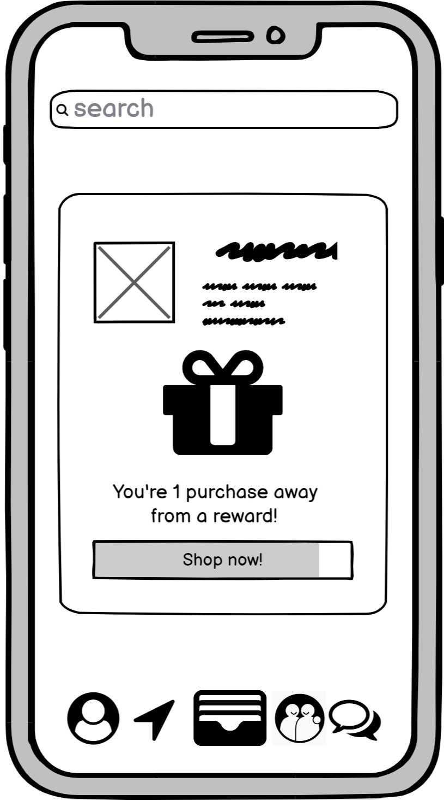
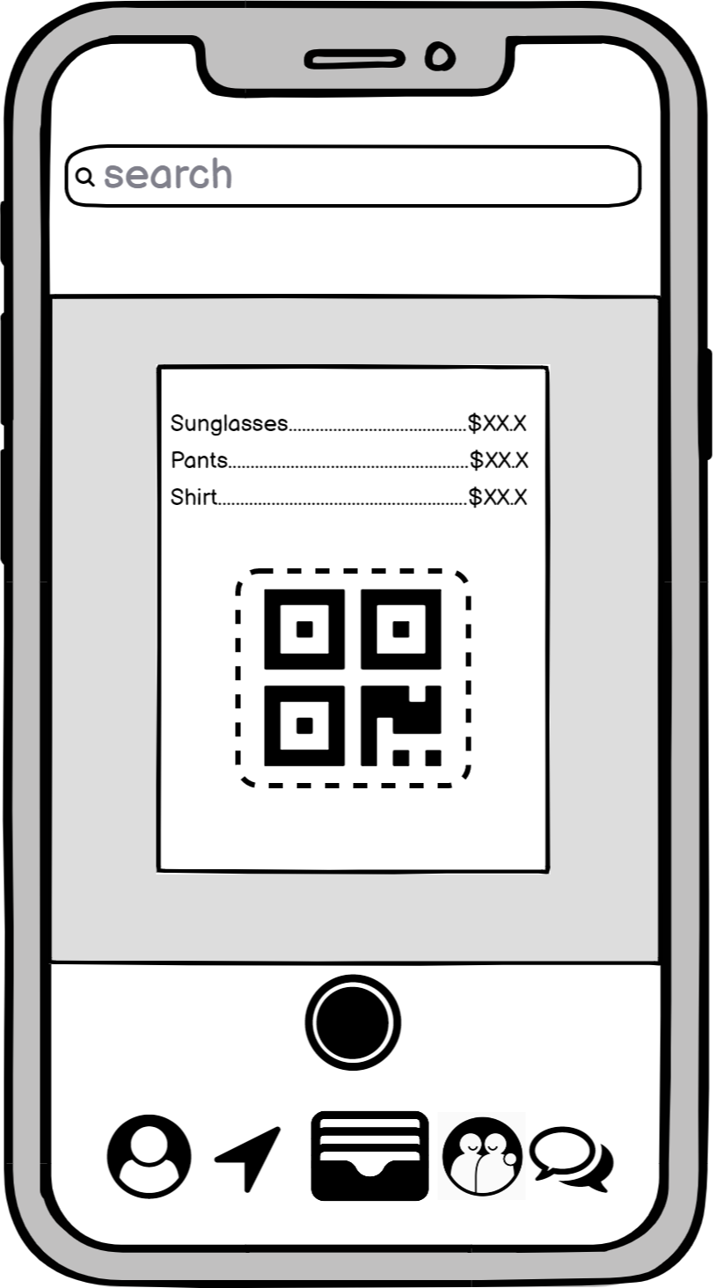
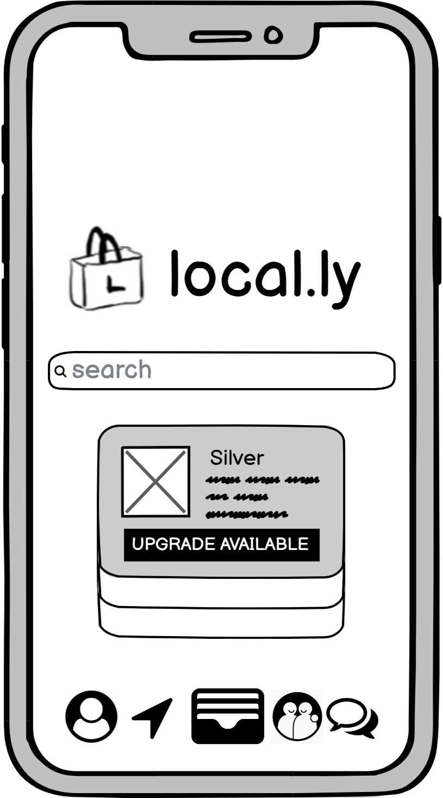
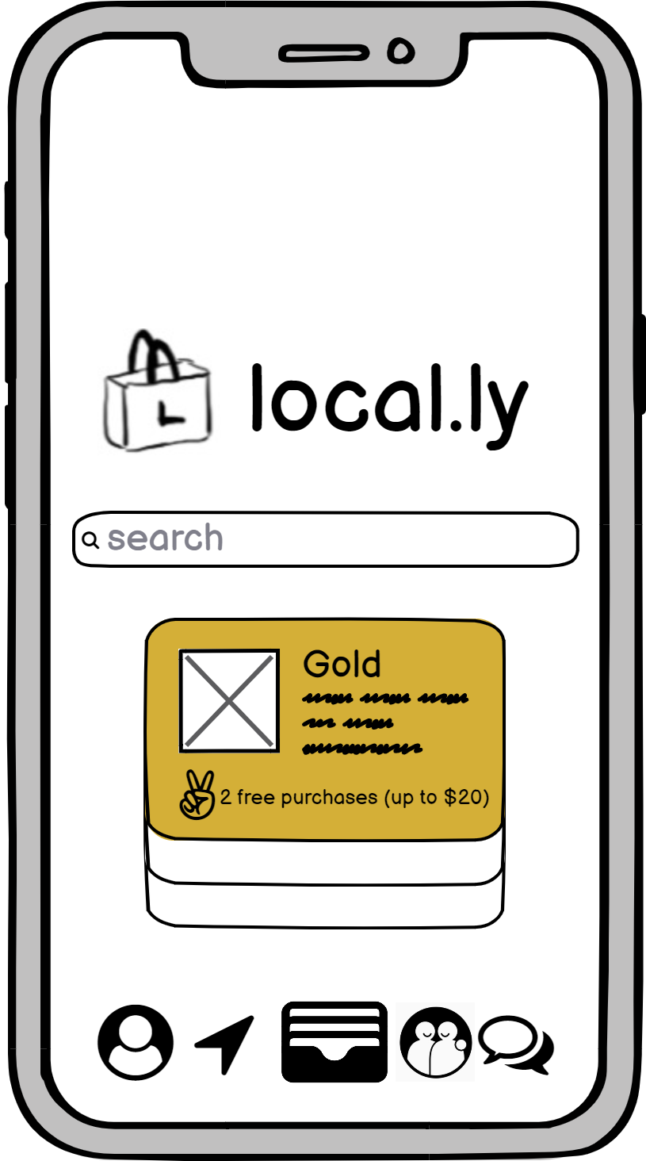
Task #2 - Build relationship with local businesses

Slide 11
Task #3
Discover new businesses with similar values
Notes:
He makes notes of recommendations from colleagues / friends and girlfriend keeps detailed maps of pinned locations

Slide 12
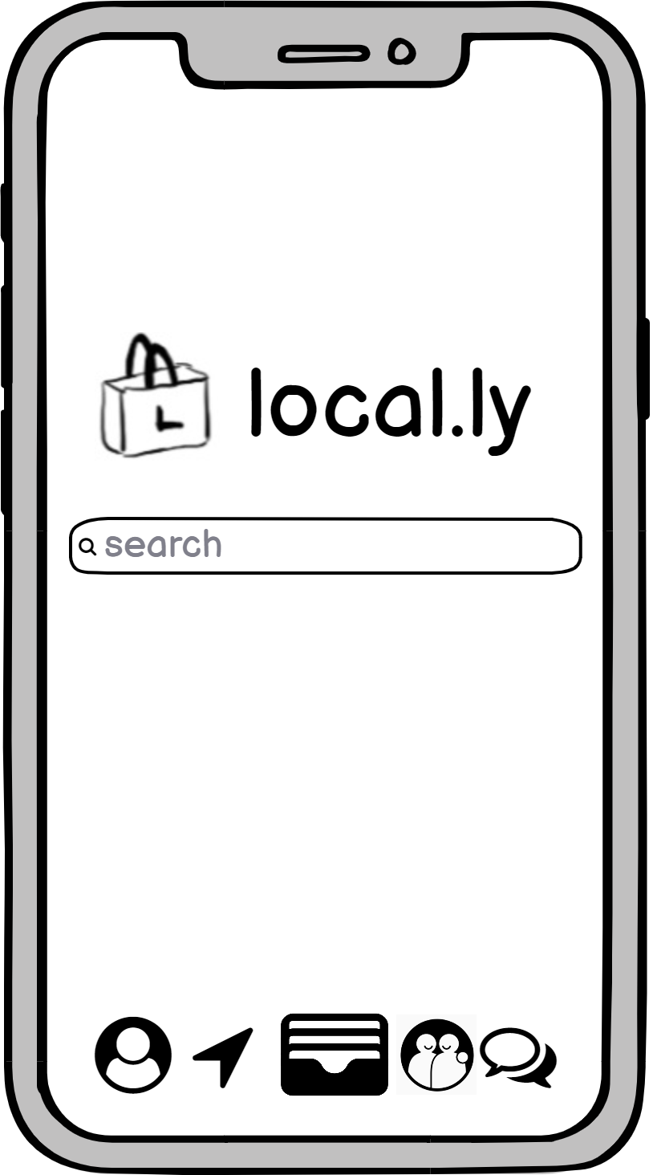
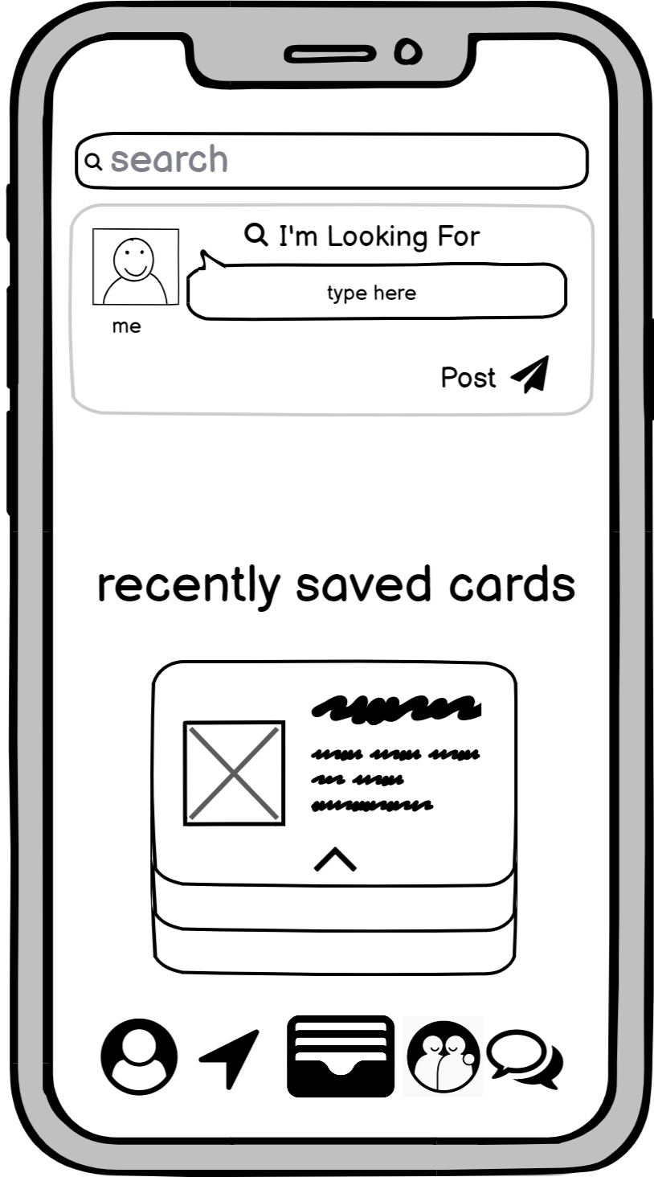
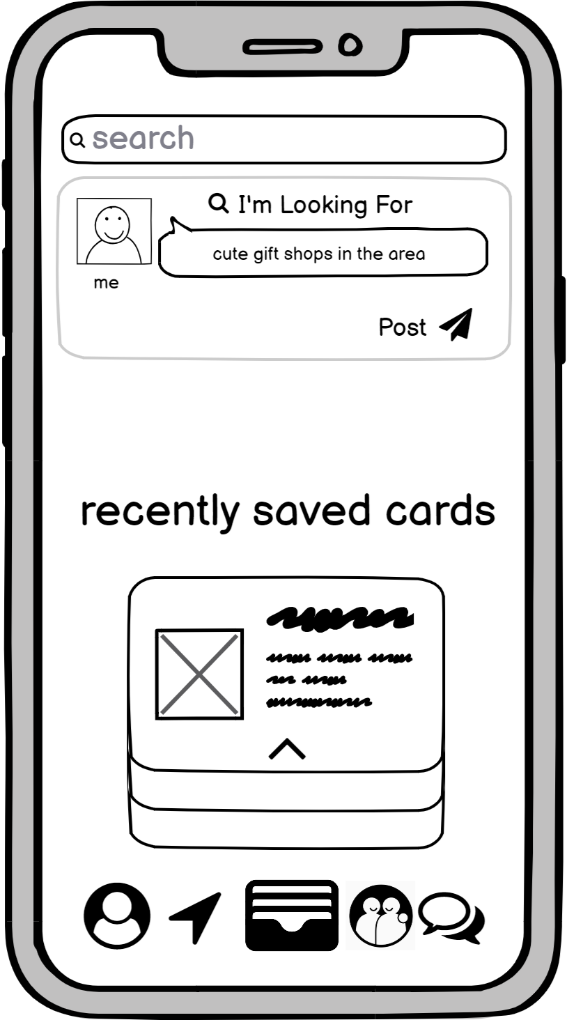
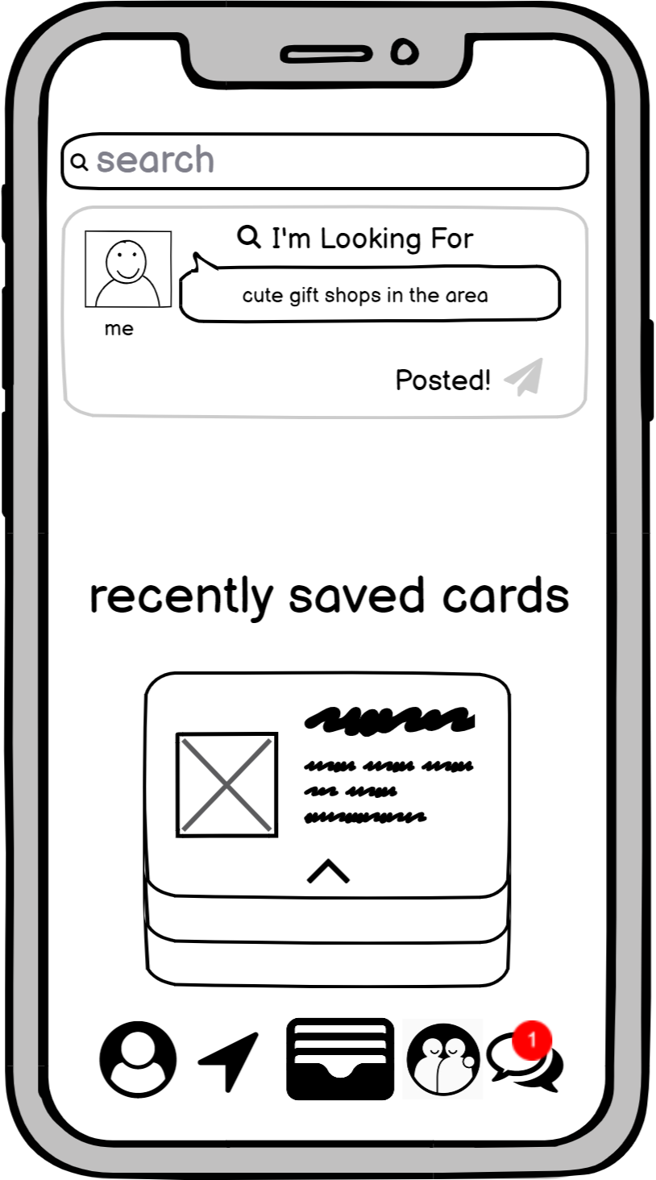
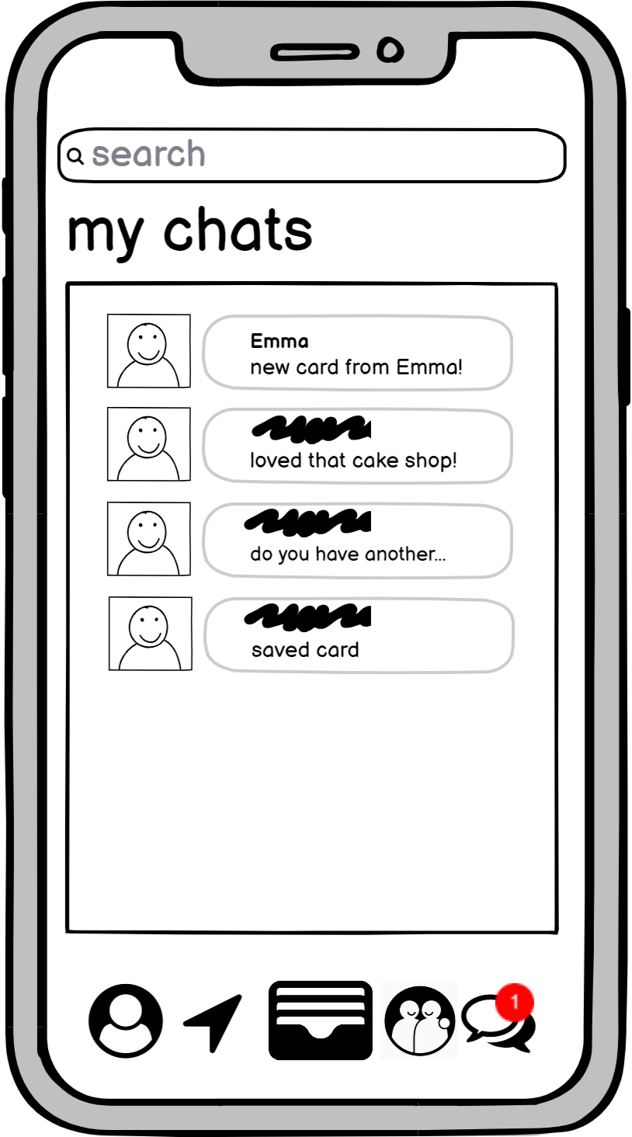
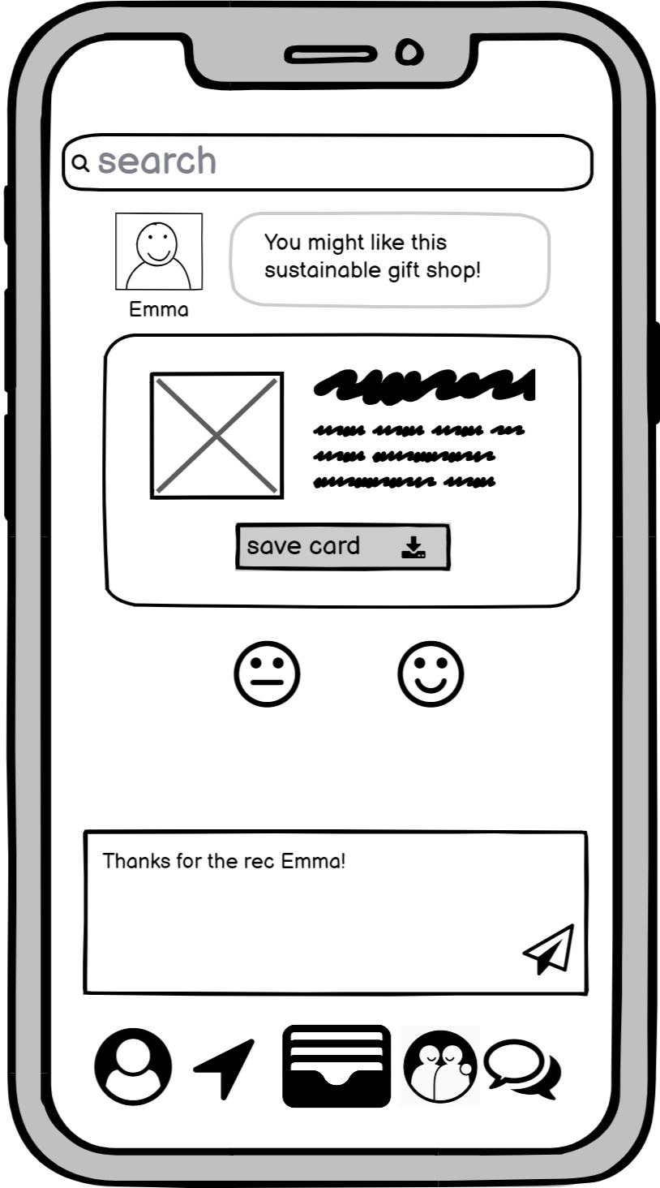
Task #3 - Discover new businesses with similar values

Slide 13
Task #3.5
Share businesses with friends
Notes:
He makes notes of recommendations from colleagues / friends and girlfriend keeps detailed maps of pinned locations

Slide 14
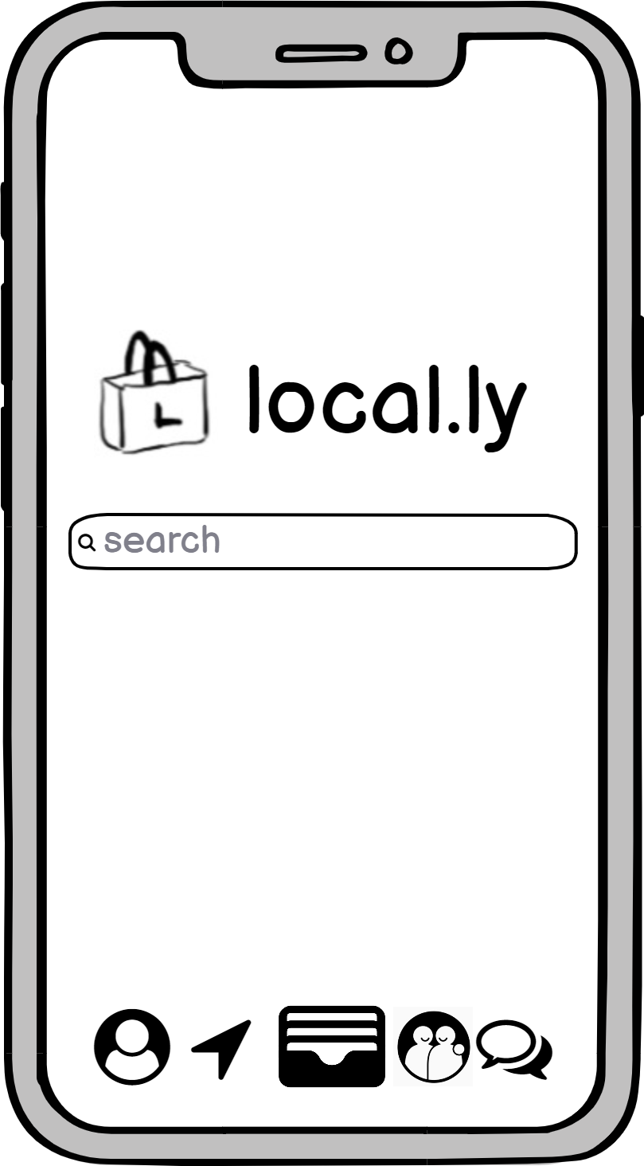
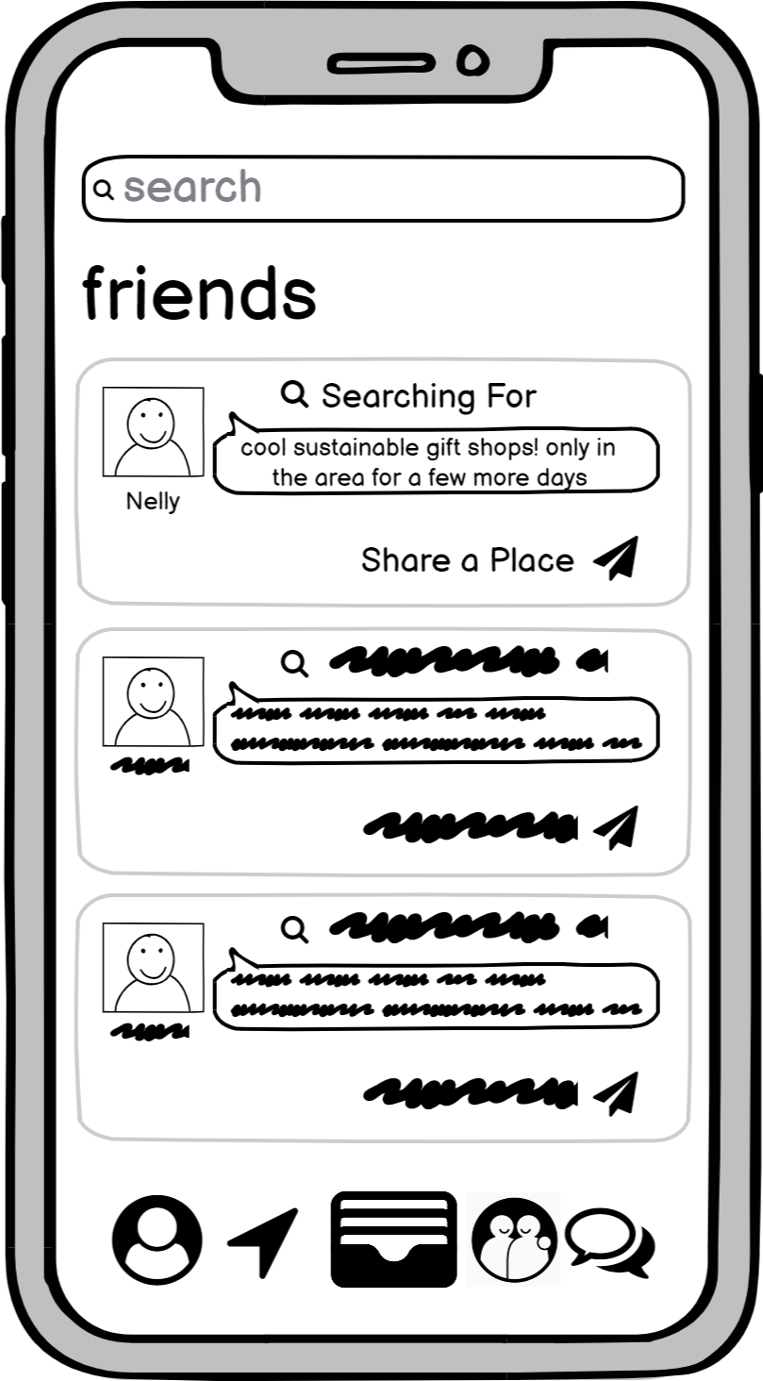
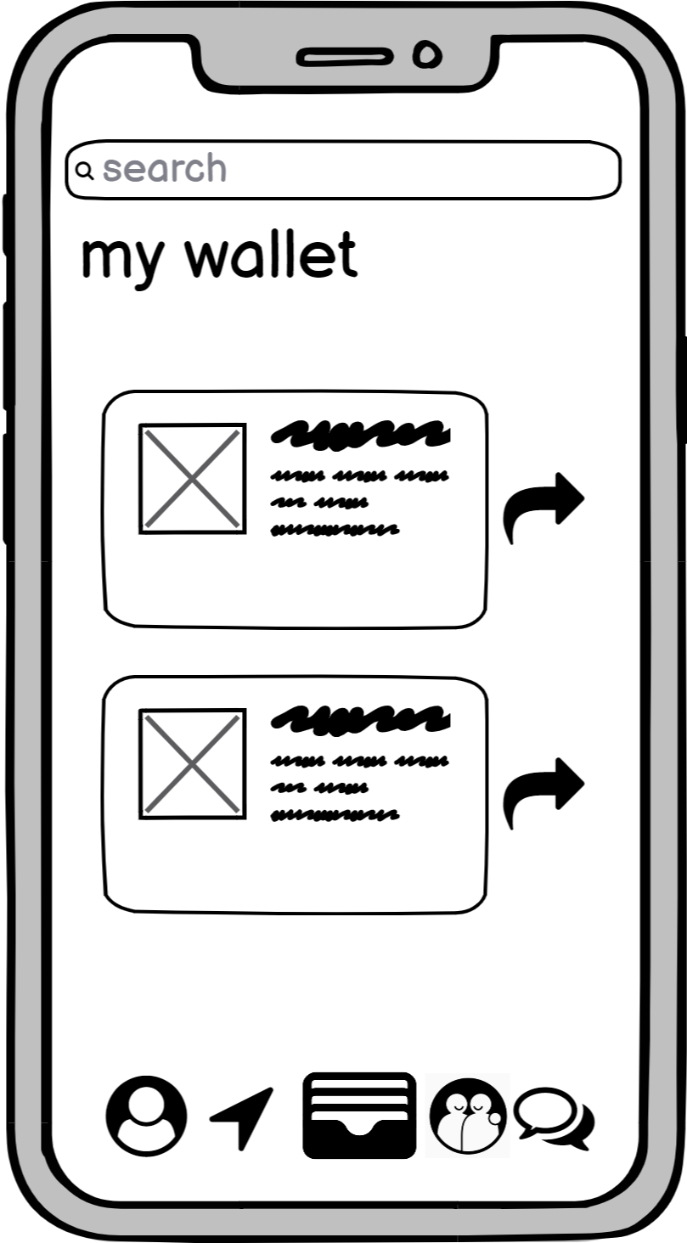
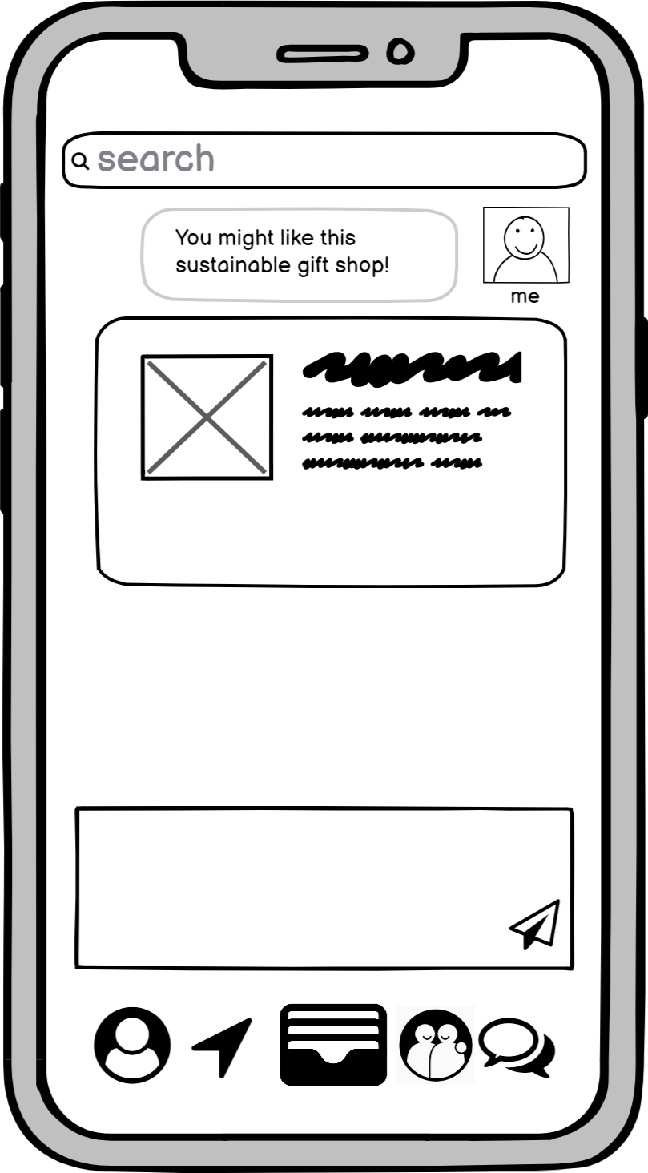
Task #3.5 - Share businesses with friends

Slide 15
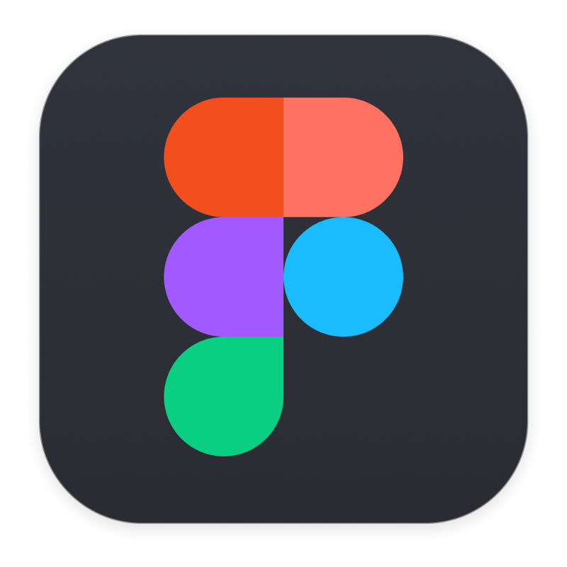

Experiment Method
Master’s Student in Public Administration
at Harvard Kennedy School
Government Contracts Management Specialist at Boeing
Fresh New-grad
Software
Engineer
At Google
Observer
Facilitator
Greeter

Slide 16
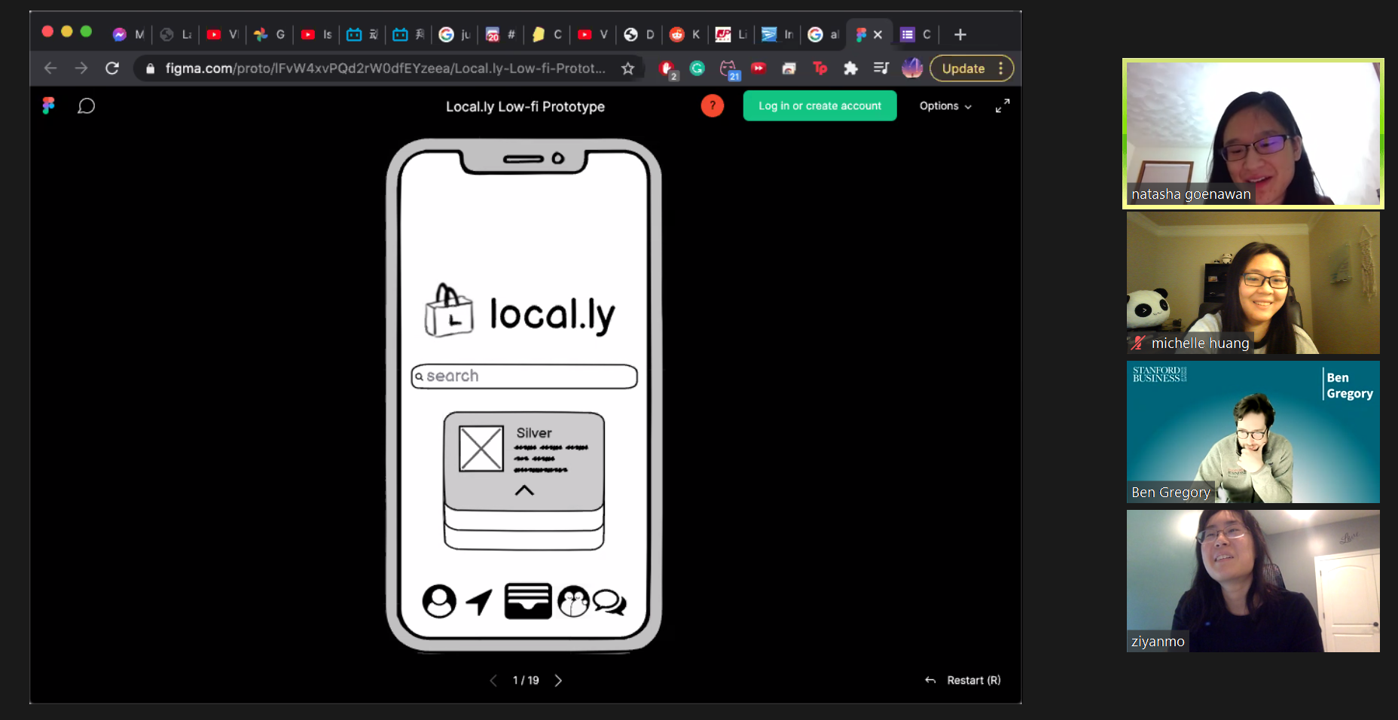

Slide 17
Results - Positives
Representation of a business as a digital card was well-understood and positively received
Sharing a card to send your friends information was viewed as intuitive
Social features “made sense” and were well-received
Search on every screen was viewed positively
“At any given moment, I might want to search for something else”

Slide 18
Results - Negatives
Representation of rewards was mixed with one person initially believing it was a “sketchy internet ad”
Unclear what caused upgrade from silver to gold card status + mixed reaction
“Build a relationship” caused users to go down the wrong task flow because of the icon of two friends
Feedback smiley faces caused confusion

Slide 20
Suggested UI Changes
Update Home button (icon and position)
Remove recommendation feedback option (smiley faces)
Update rewards bar into punch holes or stamps to indicate purchase history
Make card status (Silver, Gold, etc.) and associated benefits clearer
Delineate relationships with friends vs. relationships with businesses more cleanly

Slide 21
Summary
Users found the digital business card concept and sharing them fun and intuitive
Searching and value filters were seen as straightforward
The process of earning rewards and building a relationship with a business needs streamlining
Navigation menu and feedback icons were confusing

Slide 22
QUESTIONS?

Slide 23
Appendix

Slide 24
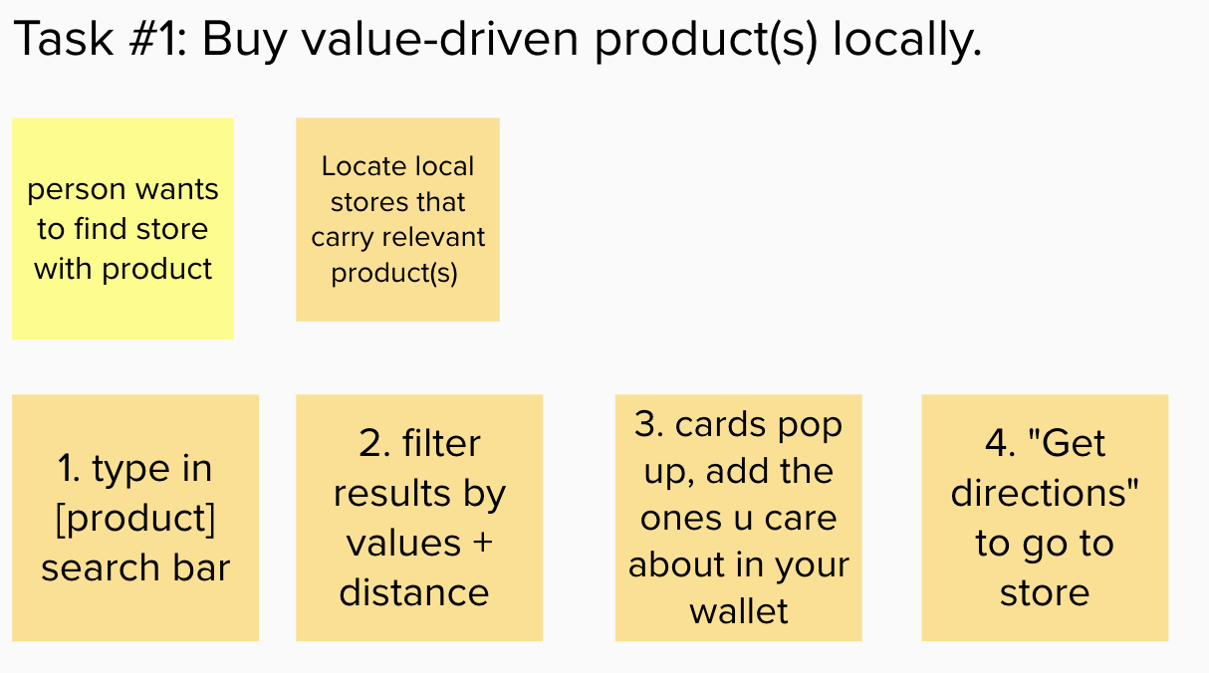
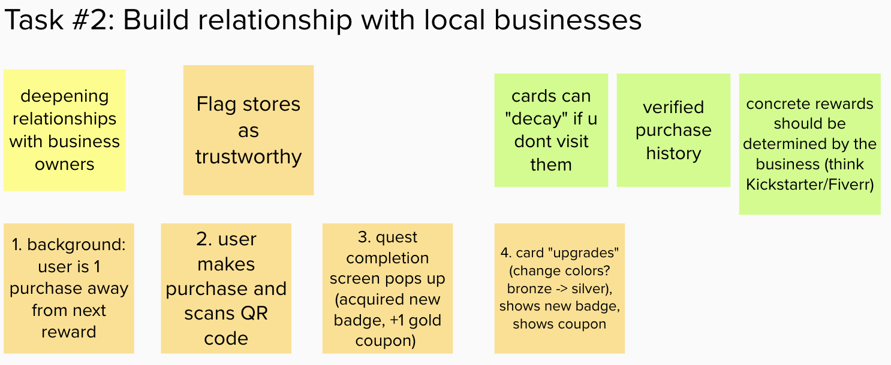
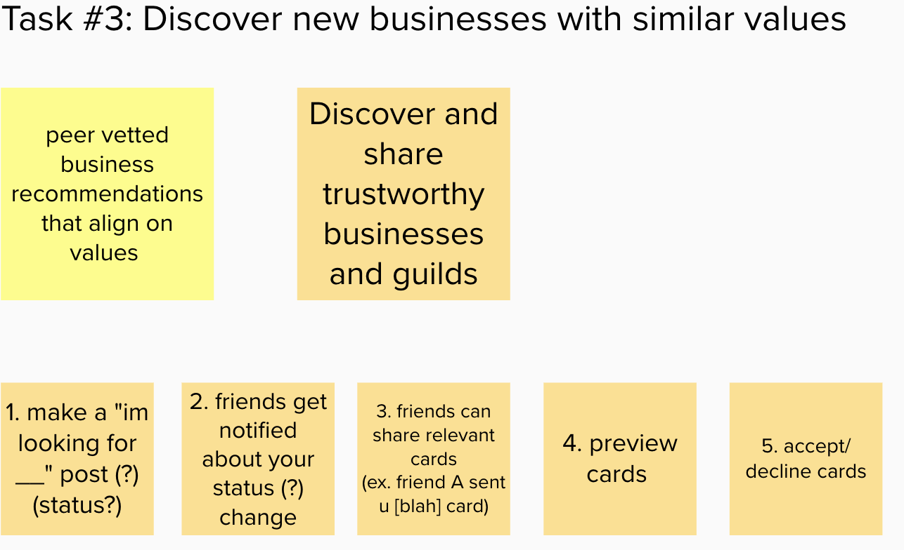
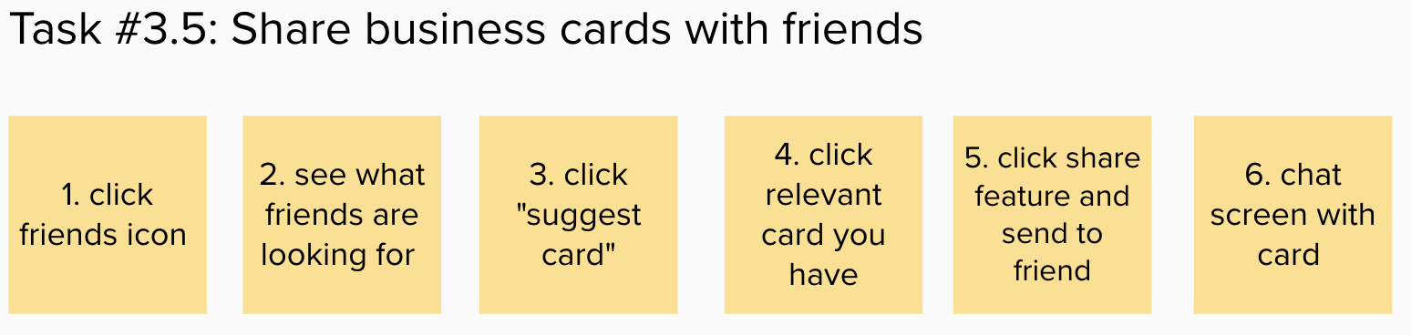
Task Simplification + Process

